Slide 1
The Real Impact of Inflation
Samuel zun
Samuel Farrell
Sami Naeem
Gabriel Millan

Slide 2
Research Topic
Our project is to uncover the difference between the reported and actual urban inflation. We will be using the CPI data, from the Bureau of Labor Statistics, with and without food and energy costs to answer this question. Additionally, we will also be analyzing the differences in inflation between the various US regions, compared to the national average, over time.
Gabriel Edits: Our project is to provide a deeper analysis of U.S. inflation from 2012 to 2022 by:
Source of our analysis is the Bureau of Labor Statistics (BLS)
Using BLS, we pulled their reported CPI, Energy (Includes Oil), and Food pricing data.
Part 1: Reported vs. Actual Inflation (Includes Food & Energy)
Part 2: Analyzed how each sector performed over the timeline
Part 3: Present our analysis in inflation across four U.S. regions compared to the national average

Slide 3
Research Questions
The research question was further divided into three parts:
Part 1
The differences between the reported and the actual inflation on a national level.
Part 2
What is the price movement for Food and Energy?
What is the correlation in price movements of Food, Energy, and All Sectors (Including and Excluding Food and Energy)?
Part 3
What are the differences in inflation between the Midwest, Northeast, South and West region of the United States?

Slide 4
Data
The data was sourced from the US Bureau of Labor Statistics.
The data consists of CSVs of normalized consumer prices from the Midwest, Northeast, South and West regions of the United States.
The data also consists of CSVs of United States National, Food, Energy and National minus Food and Energy normalized consumer prices.
All of the data is from January 2012 to September 2022.
BLS Data

Slide 5
Data Processing: DF_Processor Class
This class reads, processes and returns both regional and non-regional CSVs as DataFrames from the Data directory.
The __init__ (constructor) method sets both the regional and non-regional CSV titles as class variables.
The get_dfs method takes in the is_regional boolean flag and outputs a list of all of the requested DataFrames.
The process_dfs method takes care of all the necessary DataFrame processing we need to get our data in the right form.
The get_regional_data method returns a list of the regional DataFrames.
And the get_non_regional_data returns a list of the non-regional DataFrames.

Slide 6
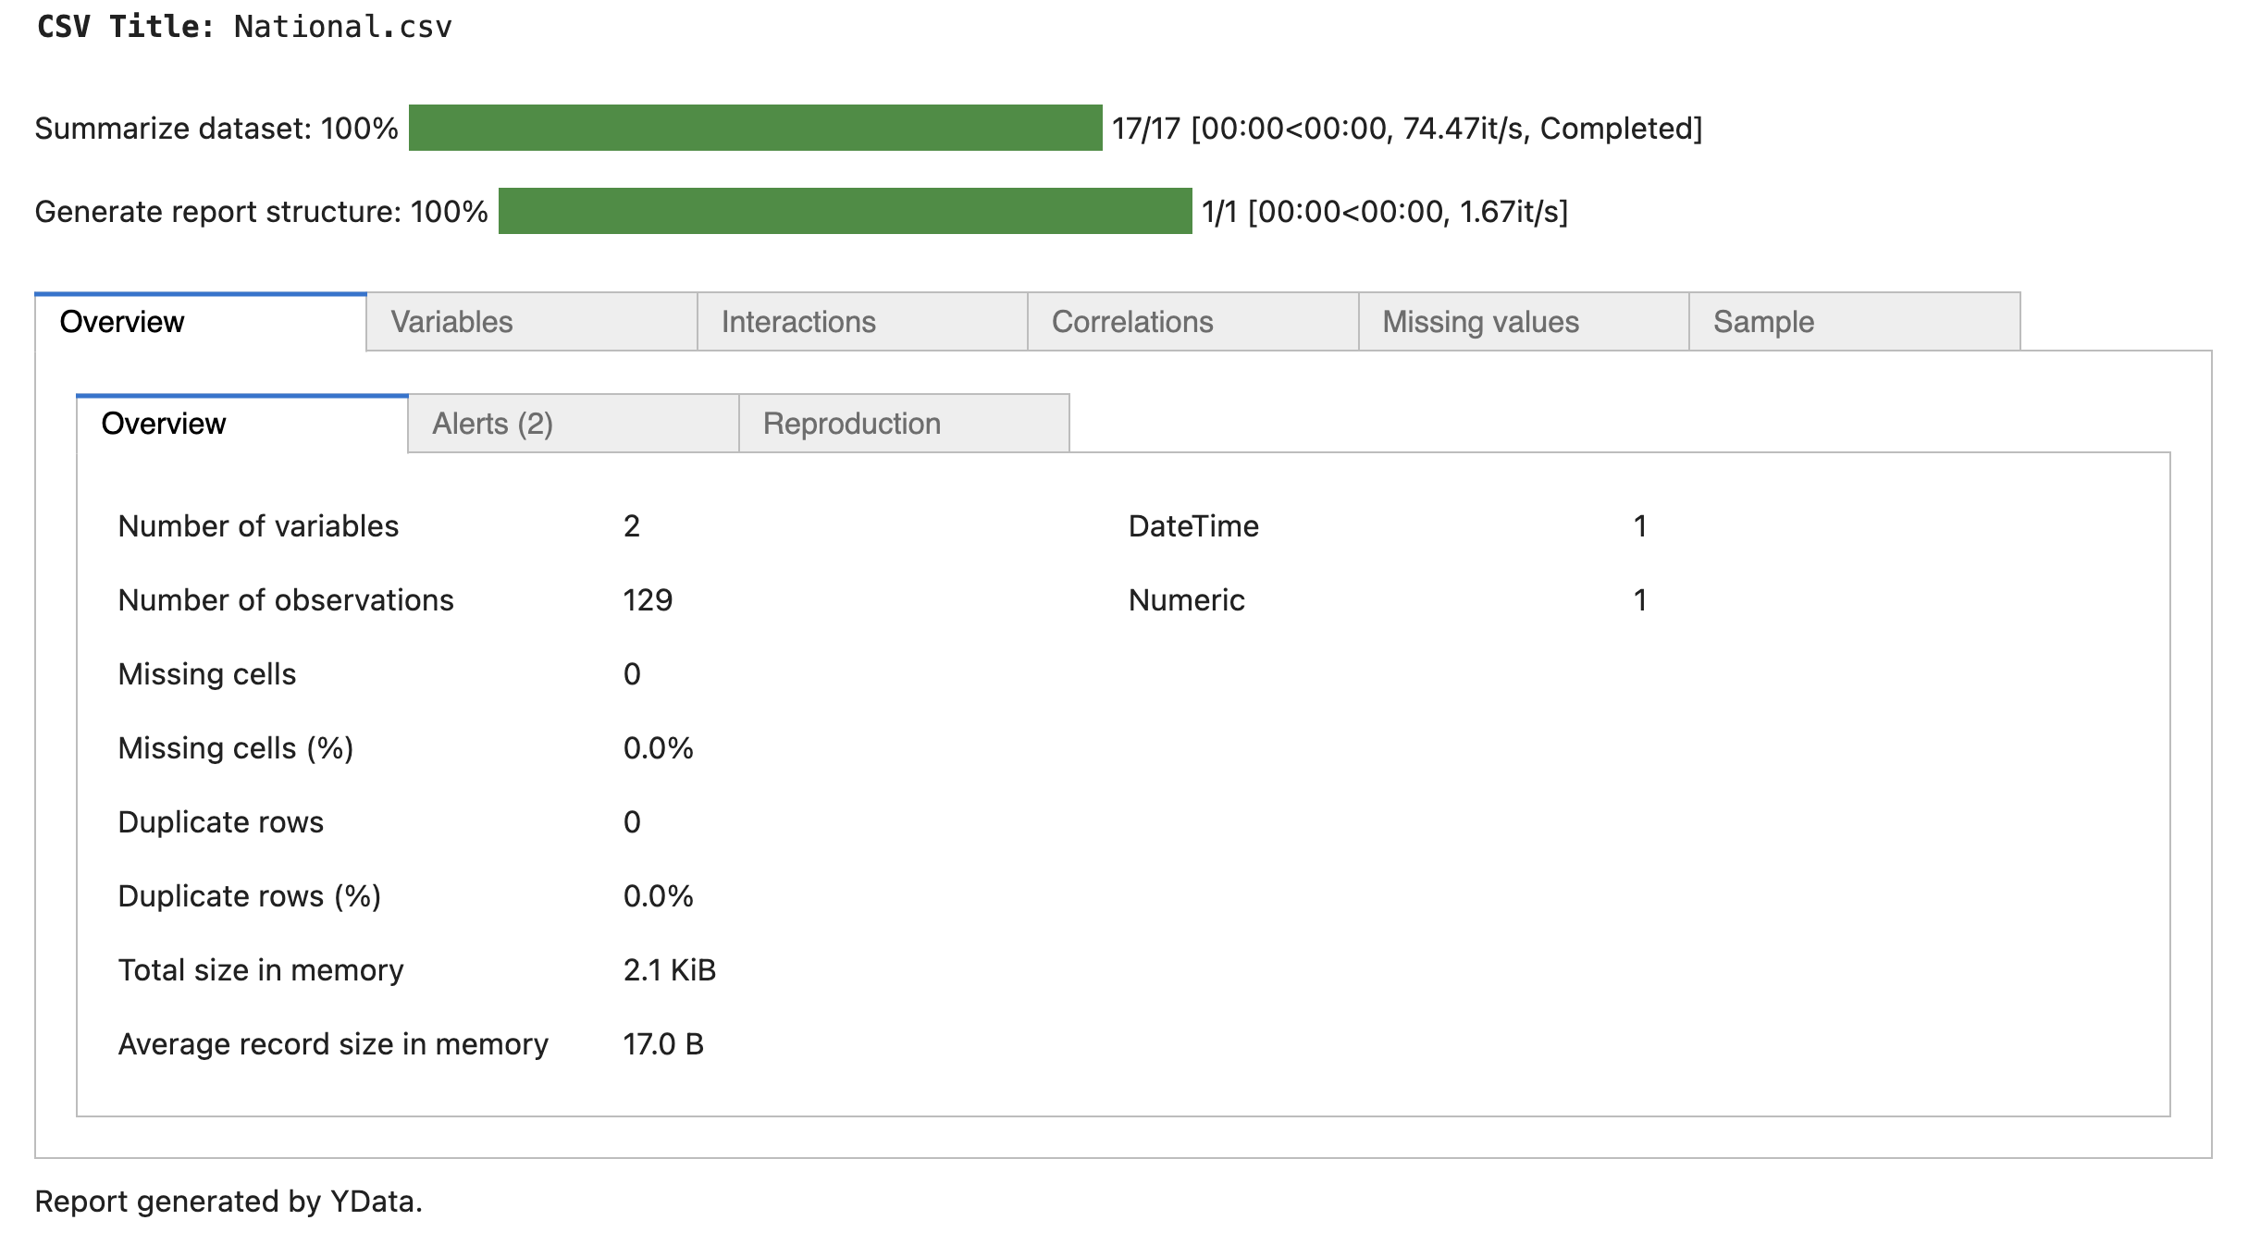
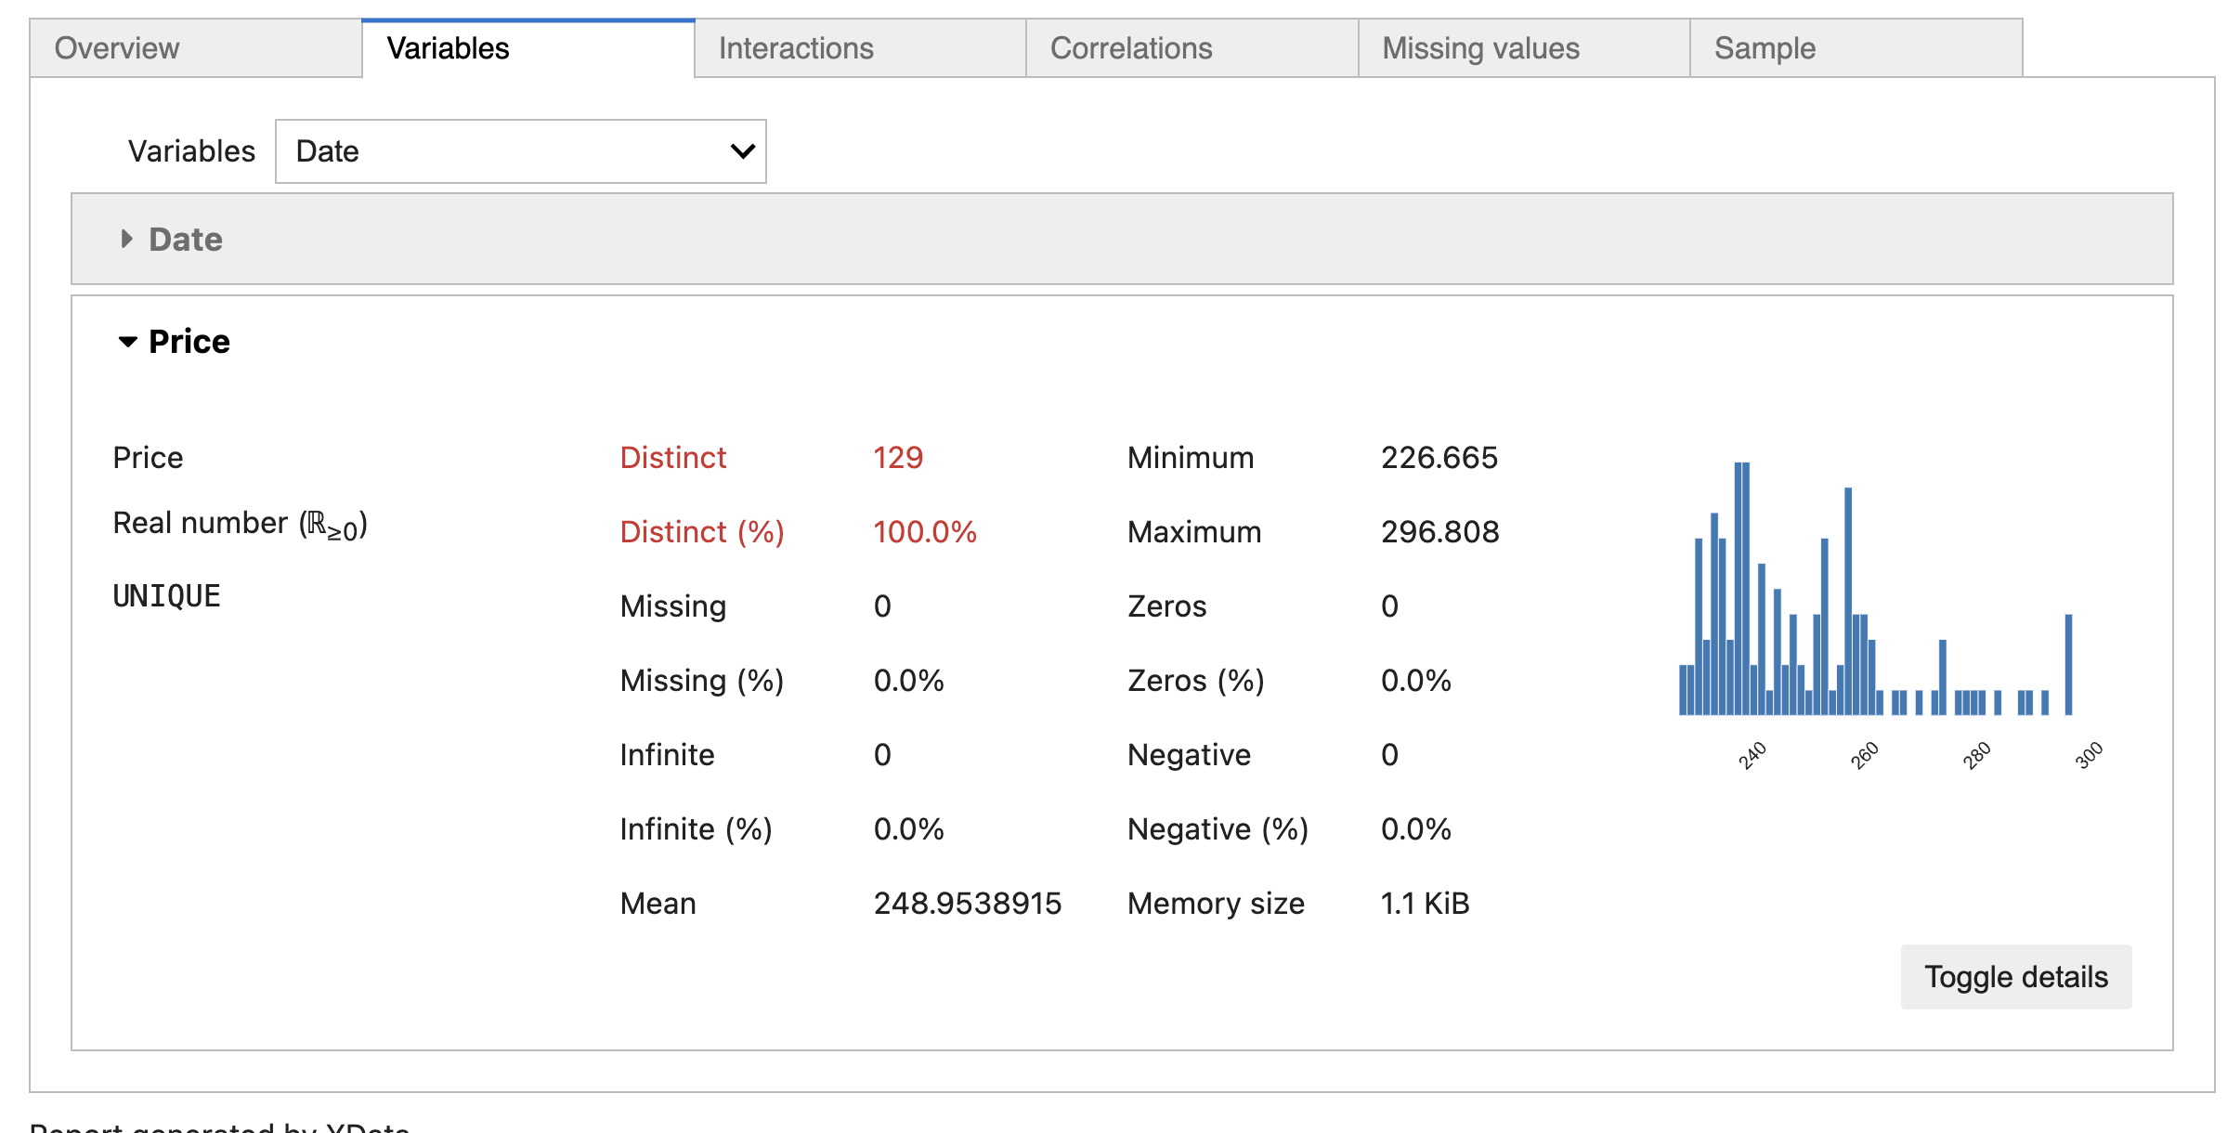
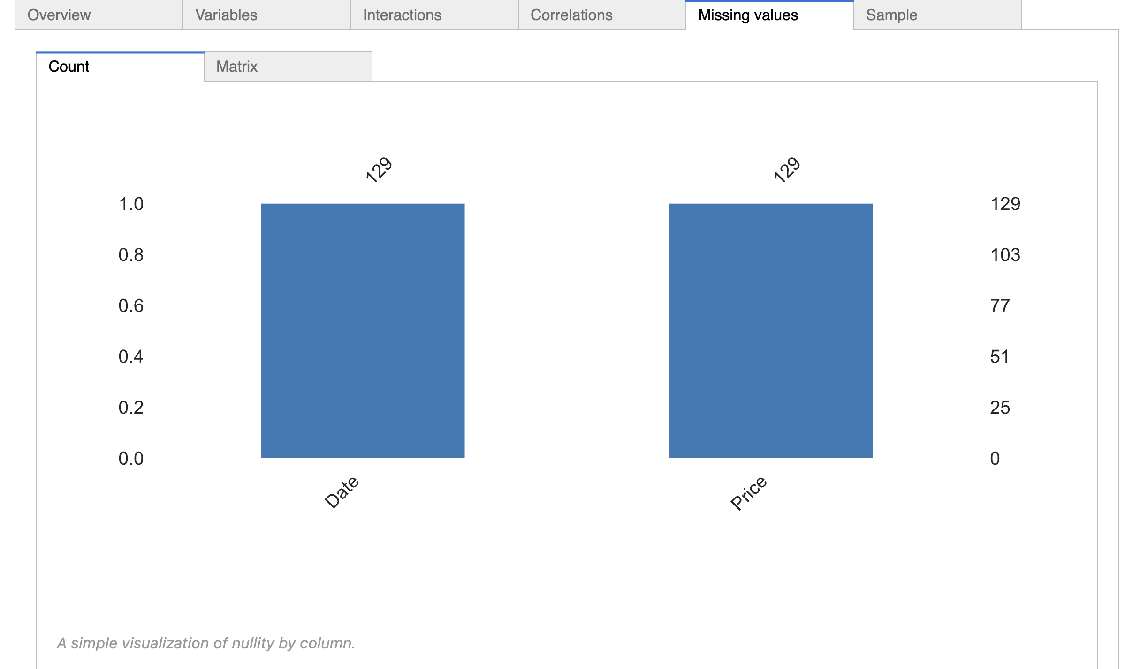
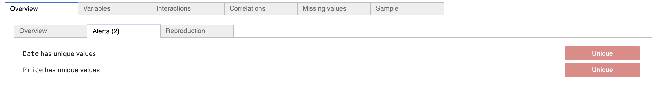
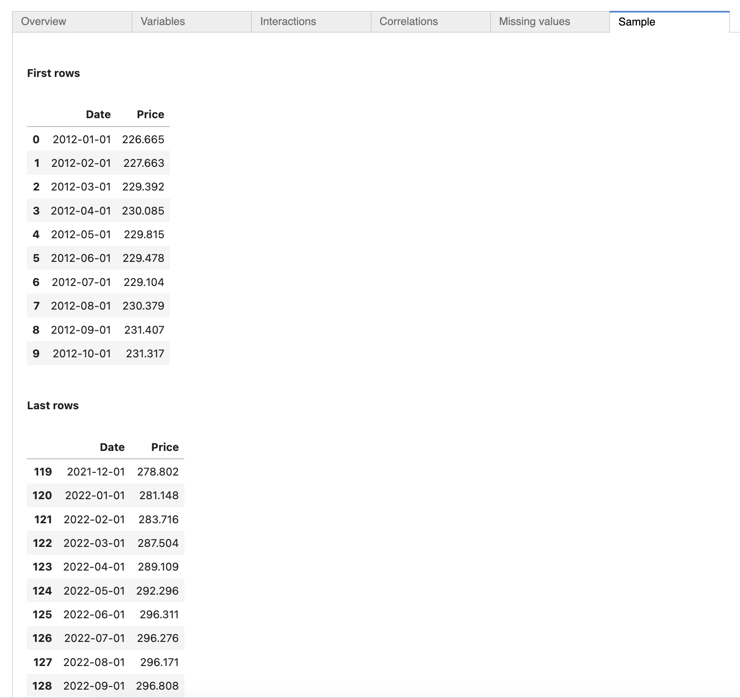
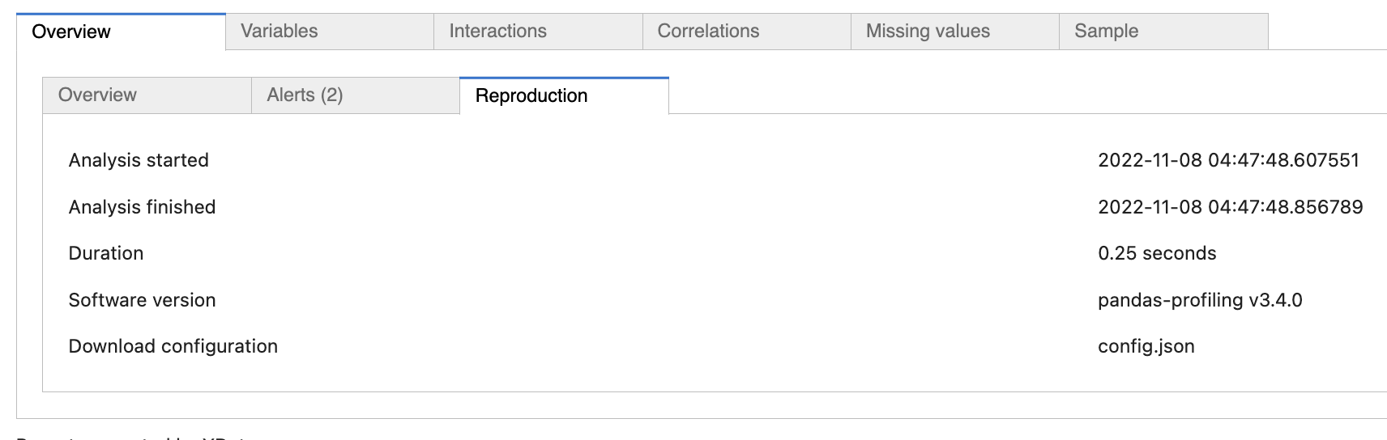
Data Processing: Report

Slide 7
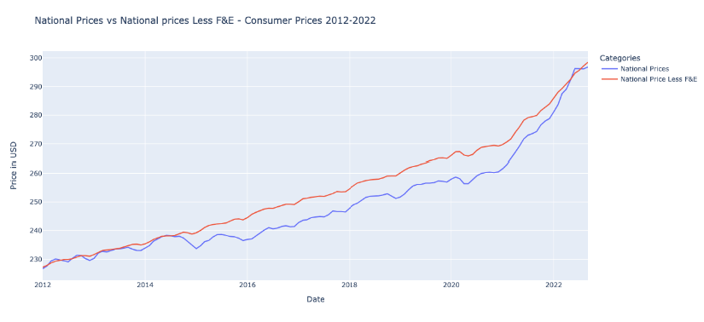
Part 1: Reported vs Actual Inflation(National)

Slide 8
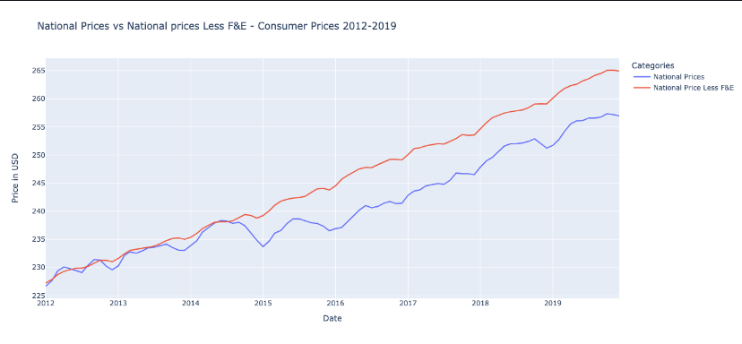

Slide 9
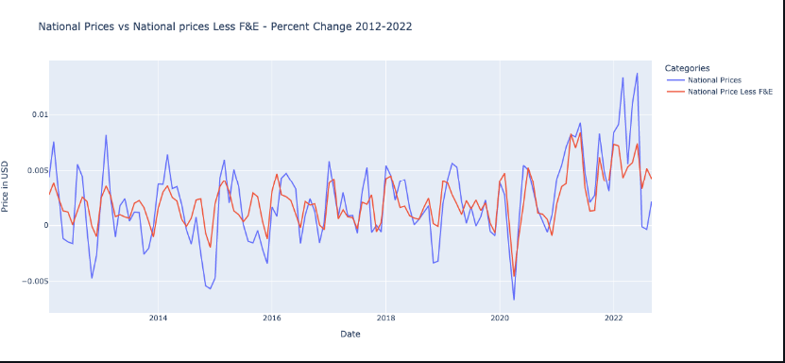

Slide 10
Explanation
Actual and reported inflation have exhibited a similar linear growth trend
Actual and reported inflation increased at a similar rate till 2014, but the actual inflation increased at a higher rate from 2014 onwards. This was caused by the food and energy prices increasing at a higher rate than the rest of the basket of goods
The actual inflation percentage change is more volatile than the reported inflation percentage change

Slide 11


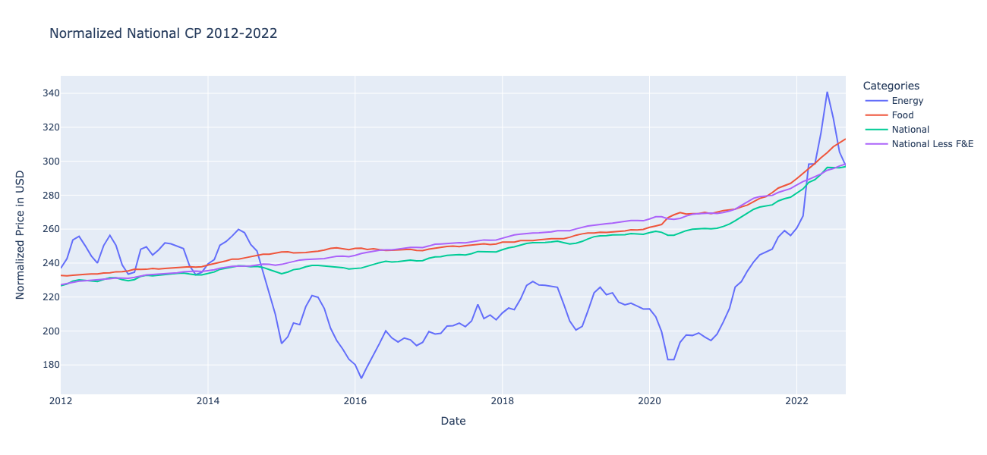



Part 2 – CPI vs. Food & Energy

Slide 12
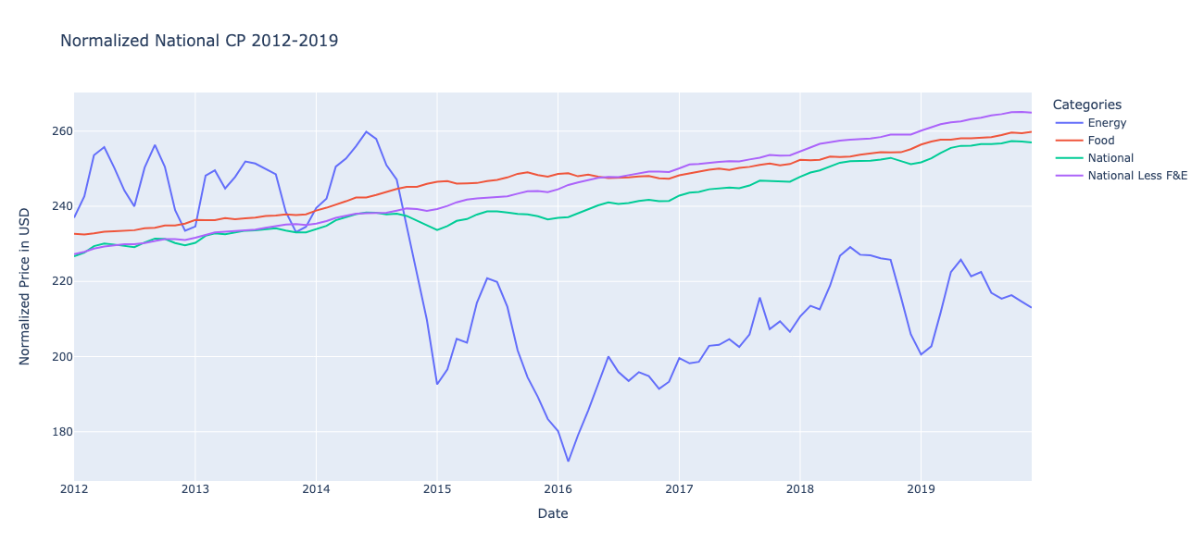
Part 2 – CPI vs. Food & Energy

Slide 13
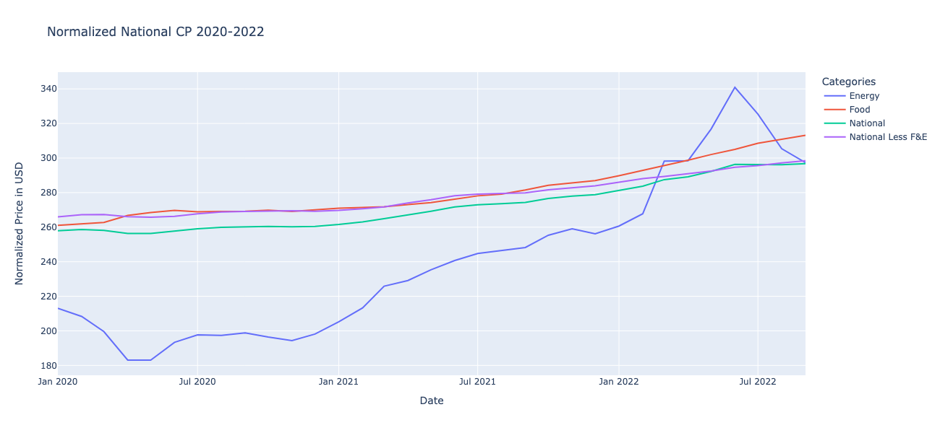
Part 2 – CPI vs. Food & Energy

Slide 14
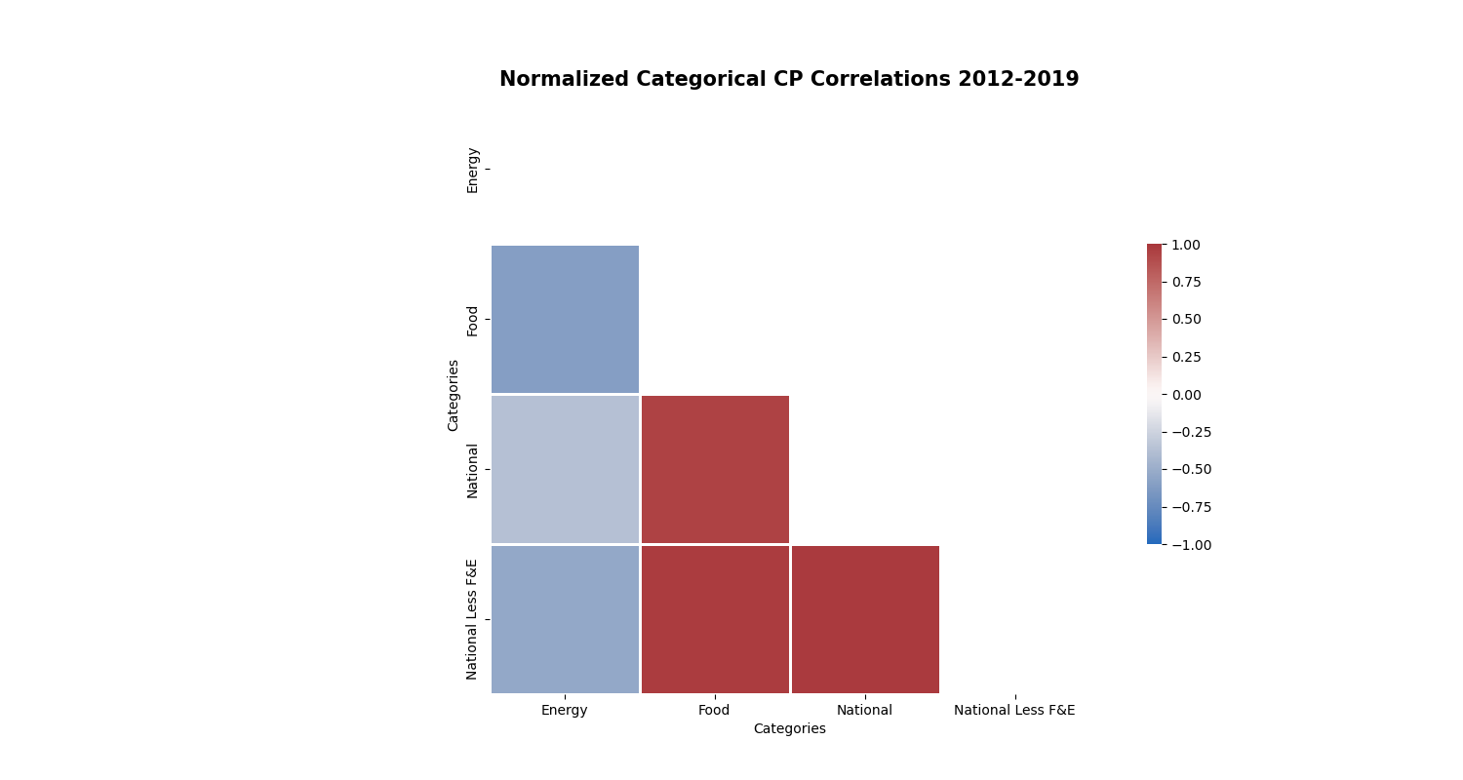
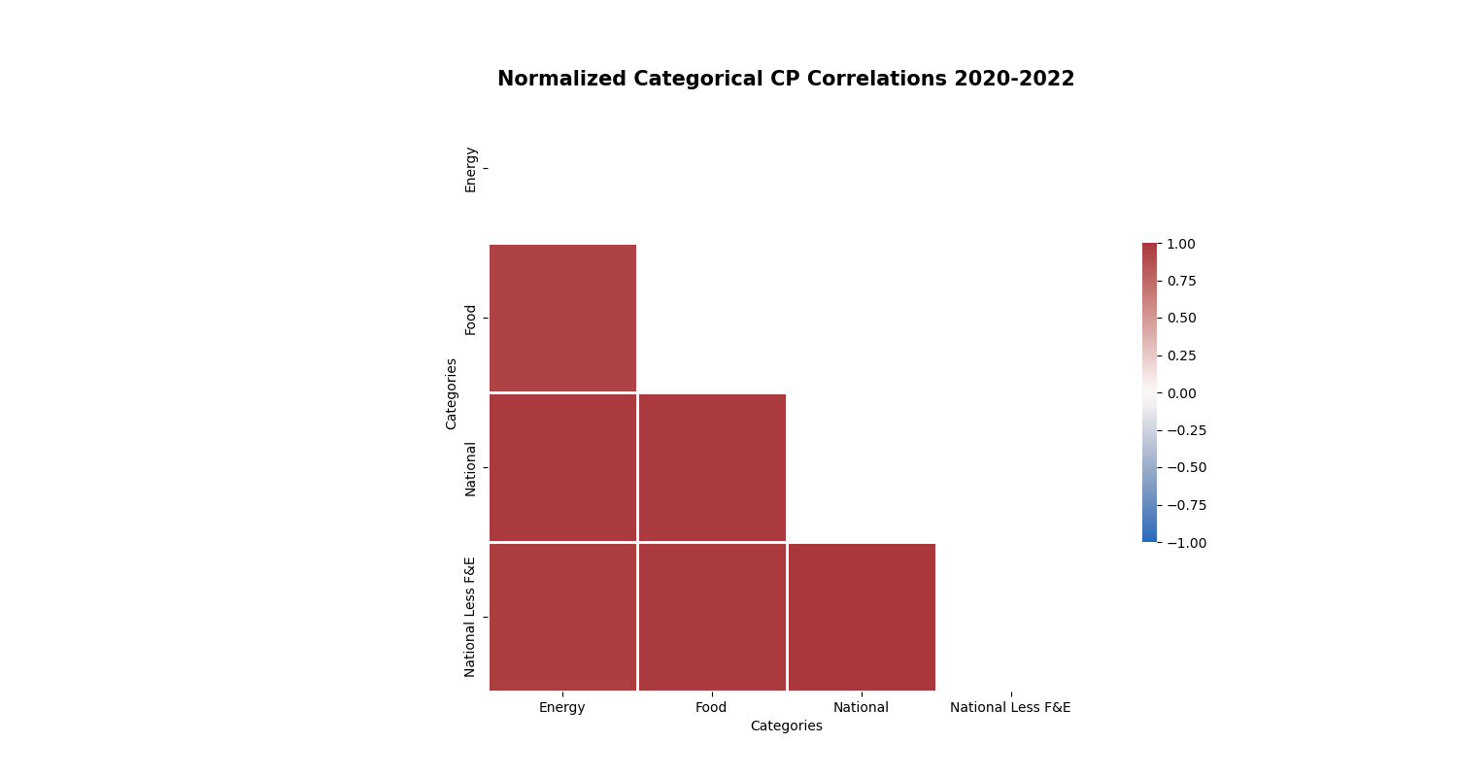
Correlation Analysis 2012 – 2019 vs 2020 - 2022

Slide 15
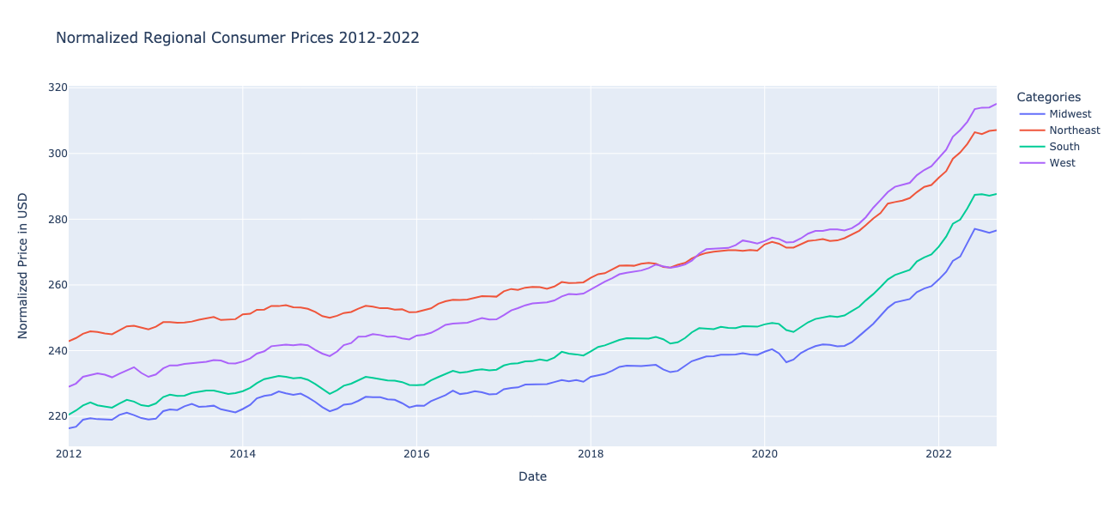
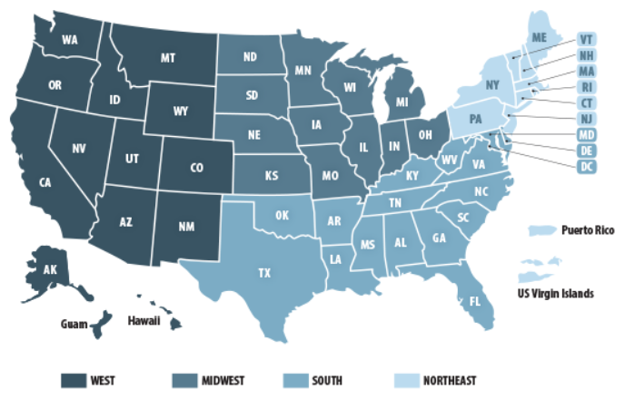
Part 3
Bureau of Labor Statistics - Economy at a Glance:
https://www.bls.gov/eag/home.htm

Slide 16
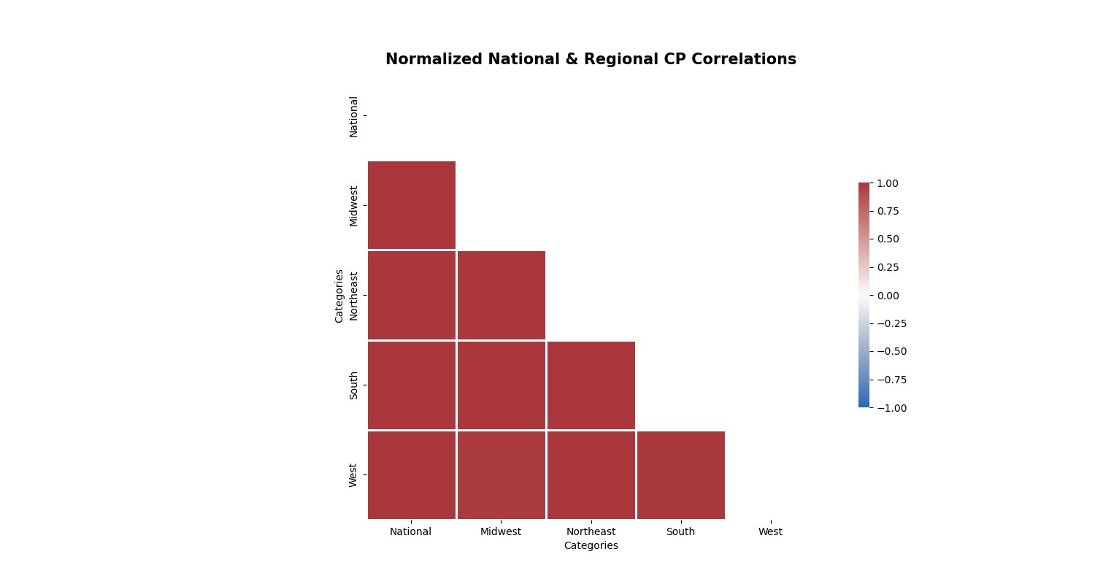
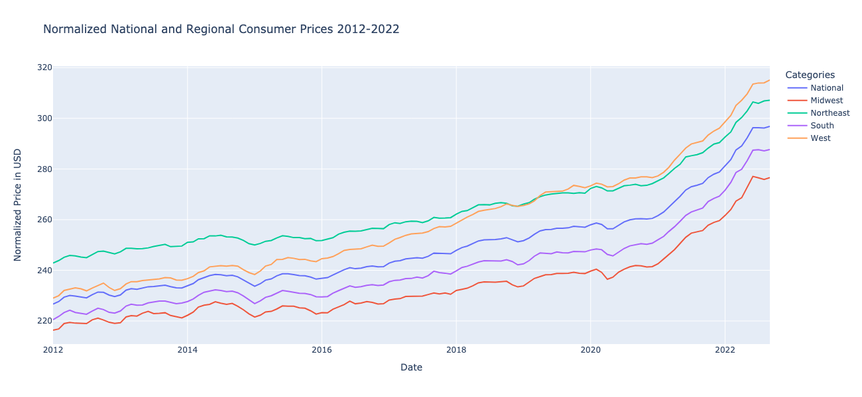

Slide 17
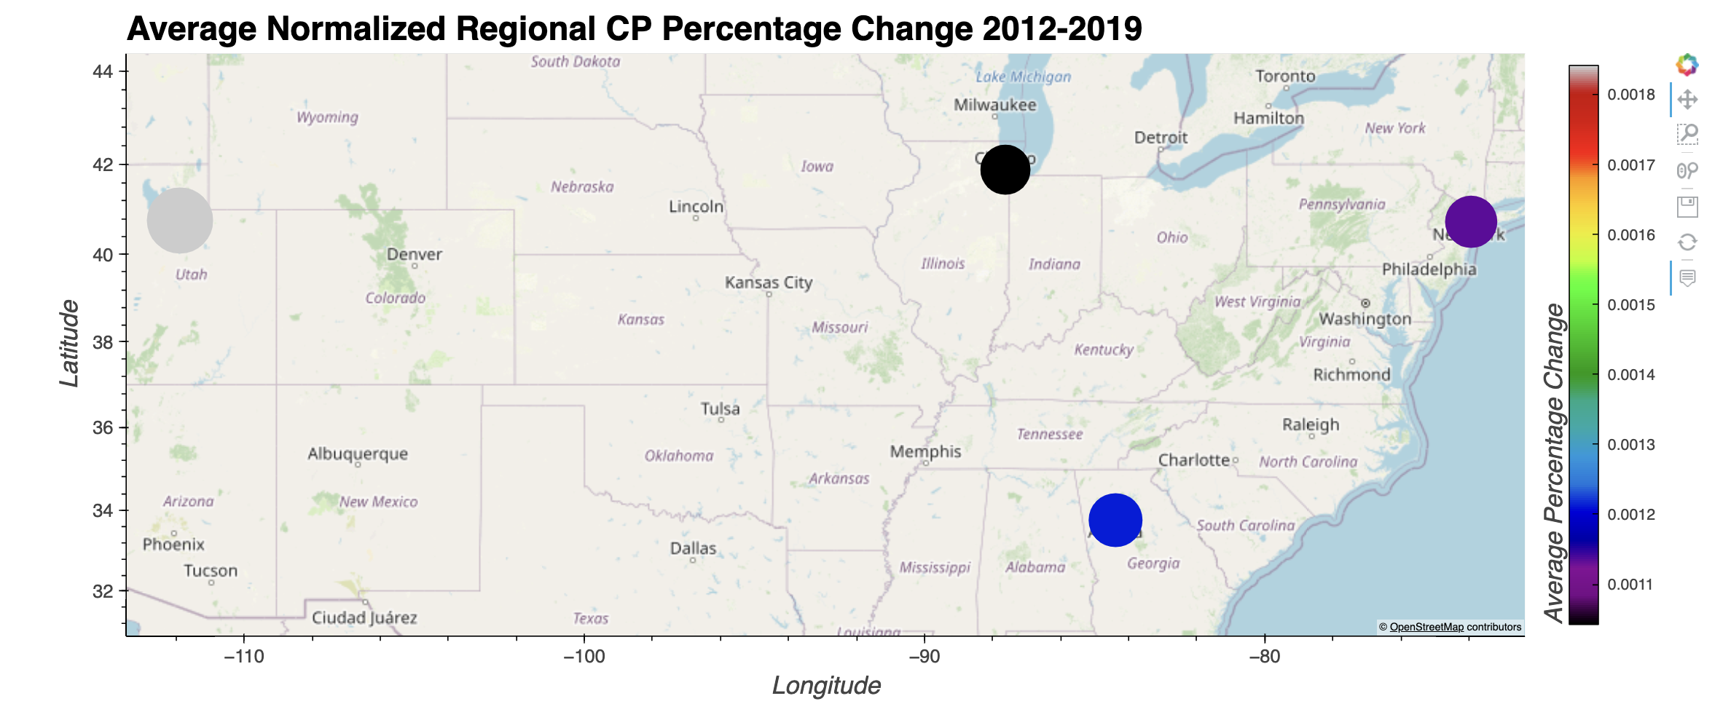
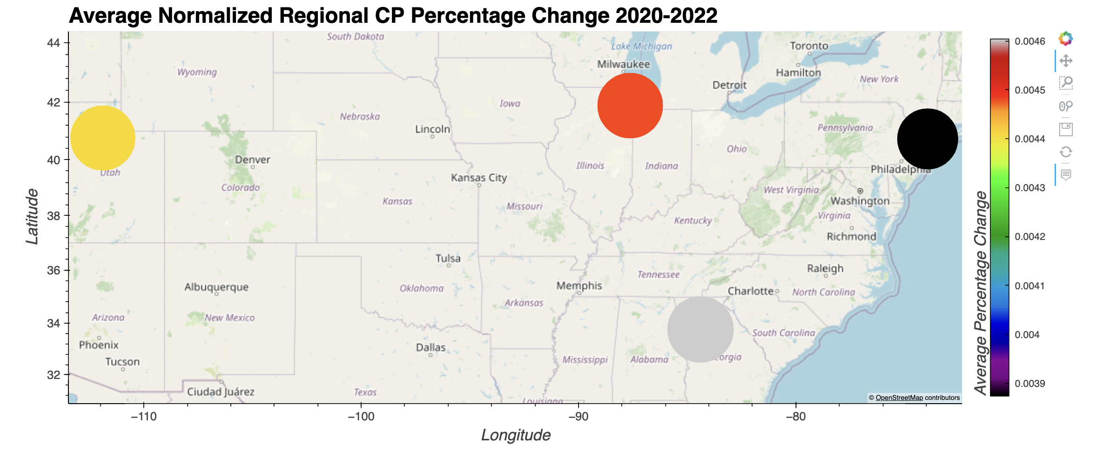

Slide 18
Conclusion
From our three-part analysis we have concluded the following:
Actual and reported inflation have a strong correlation.
Actual and reported inflation have exhibited a similar linear growth trend.
From 2012 to 2022, the price of food increased by approximately 60.
High inflationary times brings high correlations across all sectors.
Energy has a very volatile price movement and can therefore have a bigger influence of overall inflation if included in as part of analysis.
We can conclude that after 2020, the pandemic, we saw a large increase in prices across all sectors and triggering an inflationary trajectory that the economy faces today.
Prior to January of 2020 prices increased by between .1% and .18% on average per month regionally.
In the 2020s prices have increased by between .38% and .46% on average per month.

Slide 19
Additional Research Topics
The impact of inflation can be further researched by investigating:
The price changes of shelter over time
The price changes of medical care over time
The inflation trends, over time, during Democrat or Republican presidencies
The impact of inflation on the financial security of the average person

Slide 20
Questions?

